Slide 1
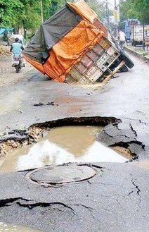
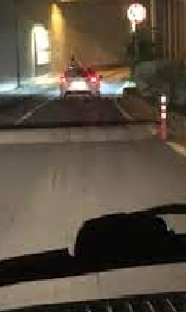
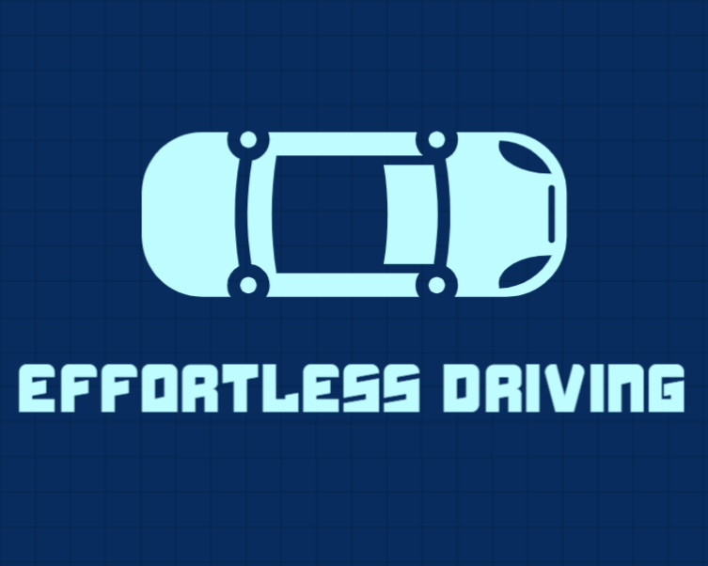

Slide 2
WHO WE ARE ?
About the Team:
Our Team is comprised of enthusiastic engineers who are dedicated to solve real life problems, making the world a better place to live.
Team members :-
Founder’s Name : Vineet Kumar
Team Member’s Name : Gaurav Jha, Aakriti Bhardwaj

Slide 3
Problem Statement
What is the pain point/problem your product/service solves?
In the current scenario, three of the biggest problems the people are facing is the increasing fuel costs, high accident rates due to poor visibility & bad weather conditions, and deterioration of the environment. We are building a model which reduce the accidents, increases the fuel efficiency of the vehicle thereby reducing pollution.
How has it been addressed and what are the shortcomings of existing solutions? How do you intend to value add?
High fuel prices, high accident rates, Bad road conditions, Global warming and Energy shortage is of paramount problem in 21st century and our solution uniquely improves the safety and fuel efficiency of vehicles. High fuel efficiency reduces air pollution, thus protects environment. Also, adding to reduced fuel cost.

Slide 4
Solution-
What are the important features and benefits your product/service solves?
Our application will improve fuel efficiency , safety, assistance in all weather conditions from hurdles/ potholes,sharp turns, decrease vehicle maintenance.
What is the company’s intellectual property position (e.g. trademarks, patents, copyrights, proprietary know-how), if applicable?
Currently, we are in the process of patenting our technology.
How have you validated your solution, if applicable?
We are at prototyping stage.

Slide 5
What is your value proposition ?
We are making an application which would be able to predict exactly where the user may stop accelerating, depending on the road conditions and traffic ahead, giving user the safest route with lesser potholes, sharp turns and high speed roads thus reducing the chances of accidents, abrupt braking and eventually, increasing safety, fuel efficiency and reducing wear & tear as well.
How & what we are building ?
We will be installing 3D camera unit in front of every vehicle, with some dedicated storage. Then, using this data to train our CNN ML/ AutoML model. We then insert this data in our global database that is accessible through our mobile application, that will work on top of Google maps as a pop on users mobile device. As of the time of submission of this document we are in the development stage of our application.

Slide 6
Target Market
What is your identified market- the addressable market(s) in which your are competing in/ intend to compete.
Our leading market/customers will be the automobile companies, who will be purchasing software’s license. Our Model will be highly flexible to be implemented by various automobile companies like Tesla, Lamborghini, Tata, Honda, etc. API provided by us can be used as embedded systems in vehicle cockpit (like TFT LCD Touch Screen) The API can also be used in Mobile Applications or Website of the Companies In the present scenario of automatisation, Our model will be apt for working with manual cars / self driving vehicles. Effortless driving is not only limited to exhaustible fuels like petrol, diesel, etc but will also help in energy consumption in electric vehicles.

Slide 7
What is the total size, projected growth, and key trends of your identified market?
Total size: Our market consists of registered motor vehicles of approx. 230 million in March 2016 in India.
Projected Growth/Market Size: Indian automotive industry is among the largest automotive industries across the globe. The India automotive industry accounts for 7.1% of the country's total Gross Domestic Product (GDP). Two wheelers market is the major segment in the Indian automobile market with approximately 80% market share, owing to a growing middle class and a young population in the country. Moreover, the market players are now exploring the rural markets of the country which has been further augmenting the growth of Indian automobile industry growth. On the other hand, passenger vehicles segment accounts for about 15% of total automobile industry of the country. India is also a flourishing automobile exporter to its neighboring countries such as Africa, Bangladesh and Sri Lanka among others and also has robust export progression prospects for the nearby future.
Notes:
Total automobile trades grew 13.01 per cent year-on-year from 2016 to 2017. Additionally, the India automotive industry is anticipated to observe major changes in the form of electric vehicles (EVs), shared mobility, Bharat Stage-VI emission and safety norms which will significantly influence the growth of automobile industry in the country.
Goldstein Research analyst forecast the automobile Industry in India is likely to grow at a CAGR of +12% during the forecast period 2017-2025. Moreover, Indian automotive industry sales of passenger vehicles and two wheelers up surged by 5.3% and 40.31% year-on-year respectively, in December 2017. Further, total automobile exports grew by 13.0% year-on-year between April-December 2017.
Road Ahead: The automobile industry is supported by various factors such as availability of skilled labour at low cost, robust R&D centres and low cost steel production. The industry also provides great opportunities for investment and direct and indirect employment to skilled and unskilled labour. Indian automotive industry (including component manufacturing) is expected to reach Rs 16.16-18.18 trillion (US$ 251.4-282.8 billion) by 2026. Two-wheelers are expected to grow 9 per cent in 2018. References: Media Reports, Press Releases, Department of Industrial Policy and Promotion (DIPP), Automotive Component Manufacturers Association of India (ACMA), Society of Indian Automobile Manufacturers (SIAM), Union Budget 2015-16, Union Budget 2017-18 Exchange Rate Used: INR 1 = US$ 0.0139 as of FY19

Slide 8
Business Model
How do you intend to generate revenue?
Our Model will be aimed at Automobile Companies, Public Transport and Commercial transport. They will use our model to make their vehicle fuel efficient, thus adding another value to the vehicle. Since, for development of model, the cost would be nominal and can be managed amongst the team, thus, for initial costs of implementation of model we will focus on backstrapping for financial aids.
Factors Affecting our costs include:
i) Training supervised model on GCP, BigQuery ML (enterprise data warehouse)
ii) App Engine for frontend and backend deployment (Asia-Pacific(mumbai))
iii) Using Bigquery for storing structured relational data
iv) AutoML for custom ML model
Notes:
In India, there are 3,00,00,000 vehicles manufactured annually [data-2017/18], and worldwide vehicles produces is more than 18,00,00,000[data -2017/18] Which include commercial and personal use four/three vehicles.

Slide 9
______Hardware cost_______
Cost of the device incorporated in the vehicle for the data transfer
3D camera unit and storage unit, will cost approx: So, total hardware cost per device per car is 25-30$
______Software Cost_________
Data storage and computing/TPU cost for model training per month:-
Data storage cost/year : 2500$ (estimated)
Computing cost/year : 5000$ (estimated)
___________Profit___________
If our model provides around 10% fuel efficiency, apart with significant profit to automobile companies, vehicle owners will save their estimated 700$ in the lifetime of the car (around 10 years).

Slide 10
What is the profile of your customer(s)?
Our customers are the companies from automobile industry, who will integrate our prototype with the vehicle and thus, providing them a USP in their vehicle i.e. increasing the fuel efficiency and making the vehicle more eco-friendly.
What is your current and/or projected burn rate?
Presently, our prototype is in testing phase, thus we have ZERO burn rate.

Slide 11
Competitive Advantage
Who are your most significant competitors?
Ours is a new and unique idea. Presently we have no competitors in the industry.
What makes your company/solution different from other competitor?
Our solution is uniquely solving the problem of fuel efficiency in the industry. Currently we have no competition.
What is your company’s sustainable, competitive advantage(s)?
It's one of a kind solution, thus ensuring the protection of the idea via copyright

Slide 12
Traction
What have you done so far/What is your current progress?
Currently, we are under developing phase of the prototype for the solution to our problem and testing it on small regional areas. We are working on its improvisation from hardware and software side. Including increasing the accuracy of the Machine Learning model and time complexity and efficiency of the algorithm, presently our main focus is on decreasing the computation costs and covering all the corner cases, which may incur in its real life deployment.

Slide 13
Go To Market
What is your go-to-market strategy?
We will be selling the rights to use our technology(prototype), directly to the companies of the automobile industry.

